Slide 1
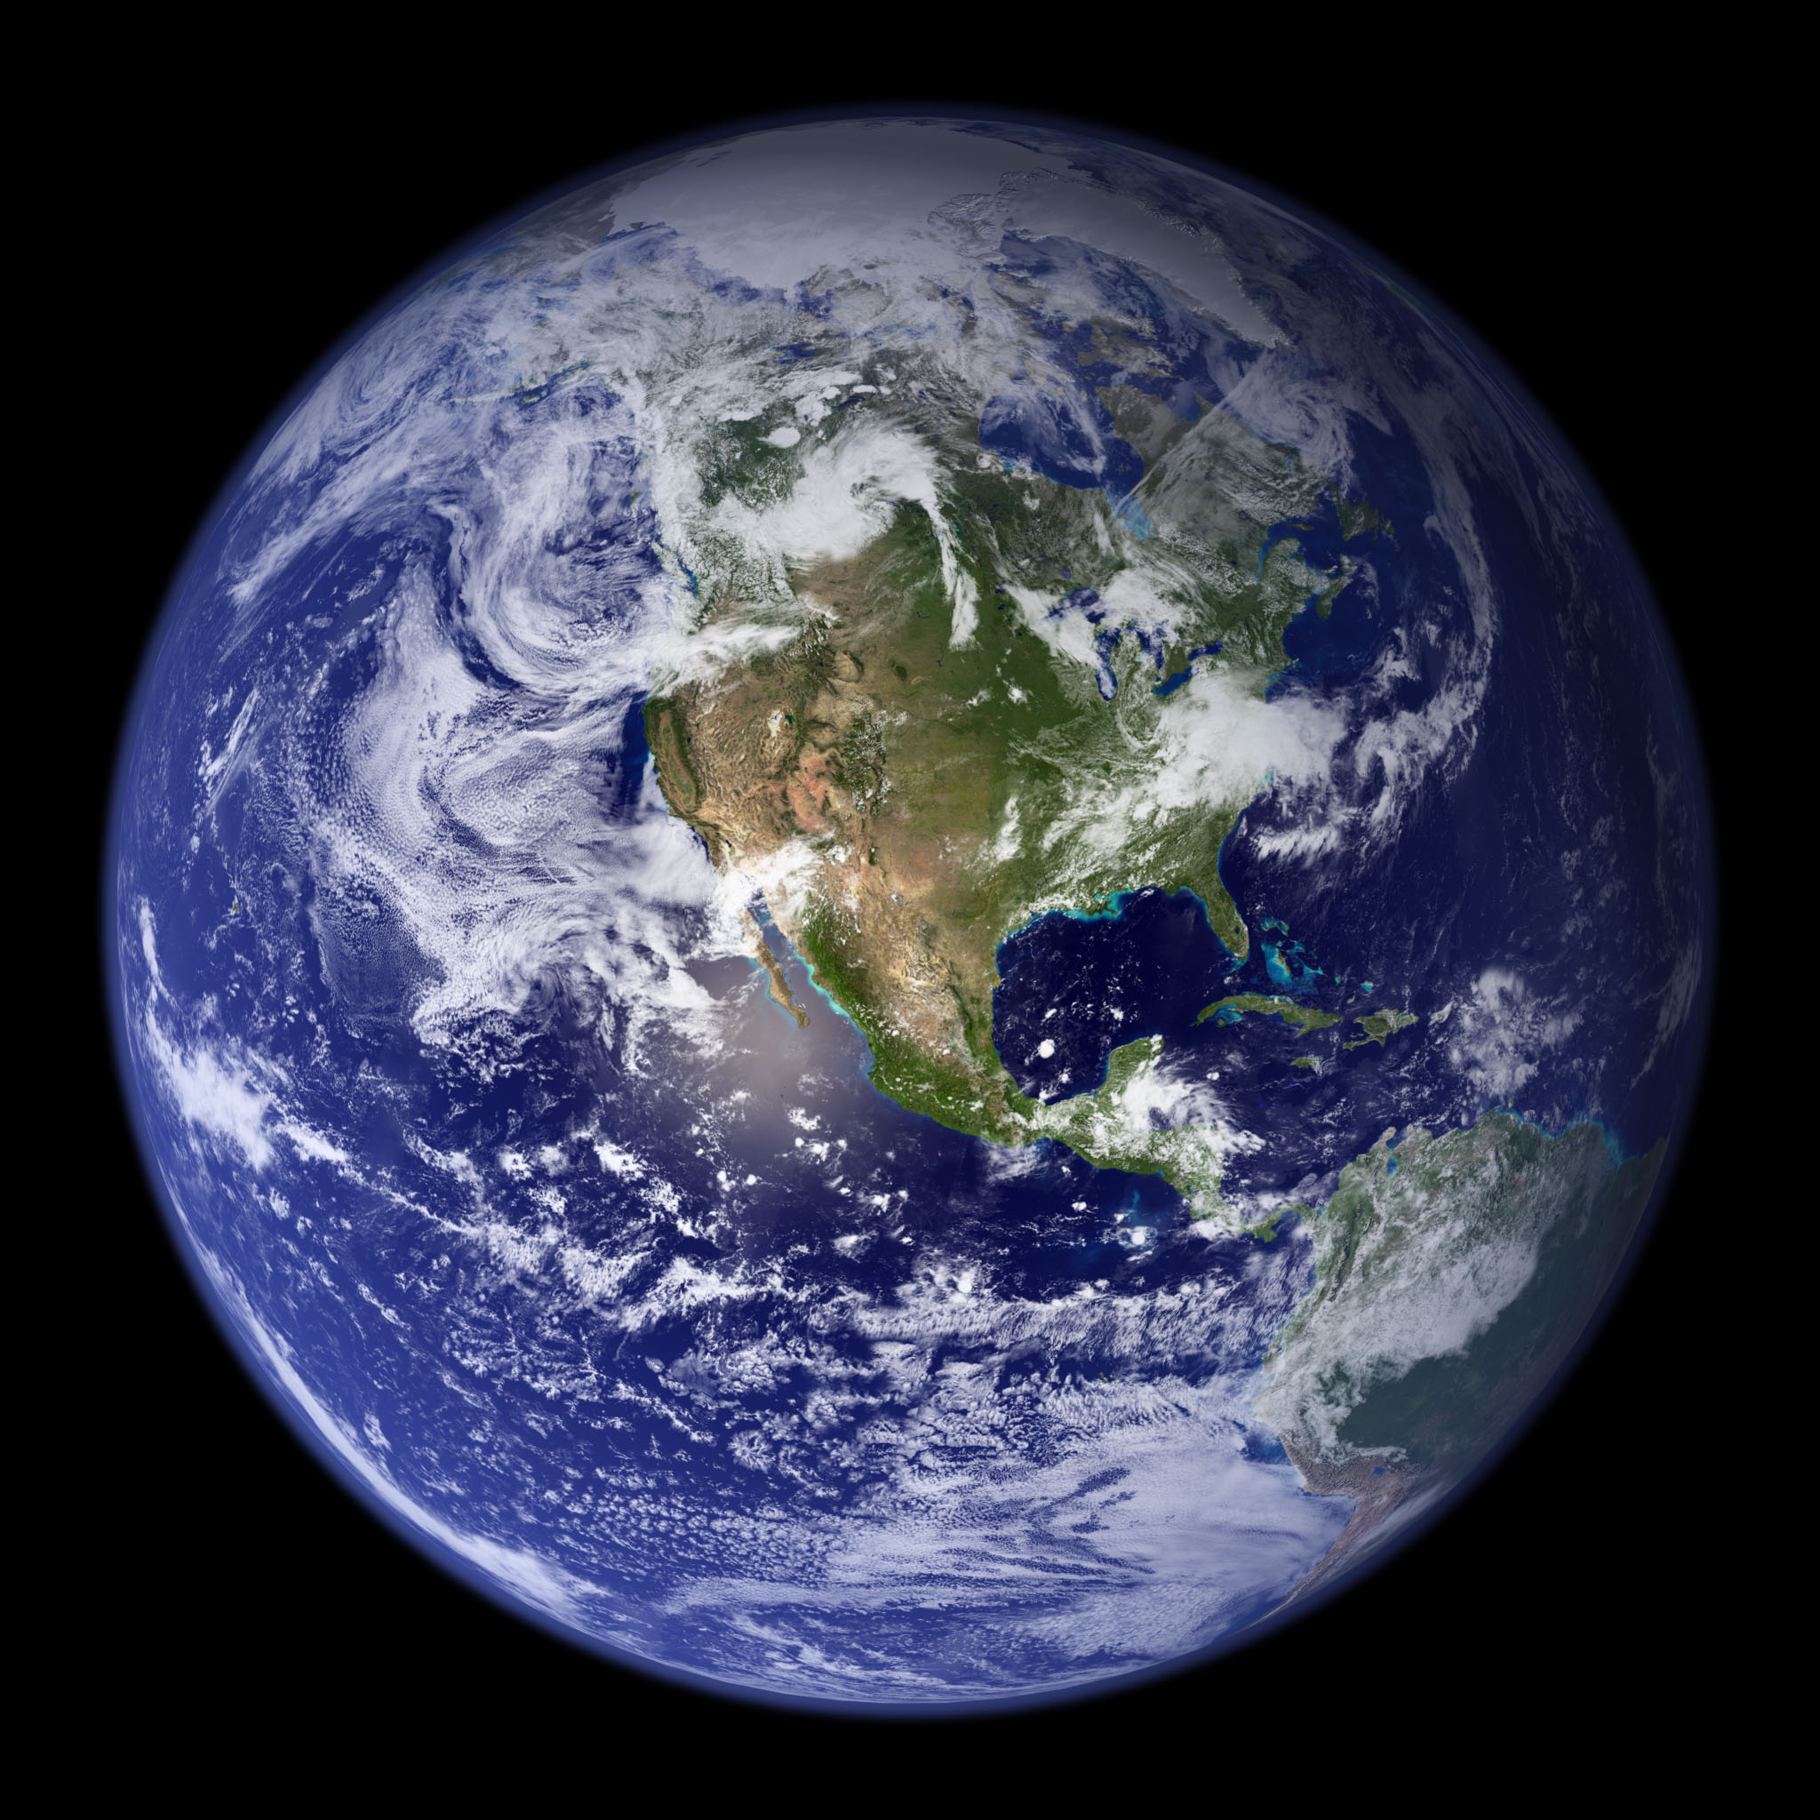

Week 2
How the atmosphere
works
552262

Slide 2
Questions from last week or videos
What controls the Earth’s surface temperature?
What controls Earth’s general circulation?
Most important control for us: Polar-front jet stream
How humidity is measured
Dry and moist adiabatic motion: An example
Kahoot!

Slide 3
Preparatory videos for lecture
Week 1: Earth’s Climate System
Week 1: Evolution of the Earth’s Atmosphere
Week 2: Composition of the Modern Earth’s Atmosphere
Week 2: Why does the atmospheric temperature profile look the way it does?
Week 2: Three Radiation Laws
Week 2: What if the Earth had no atmosphere?
Week 2: Atmospheric Dynamics and General Circulation

Slide 4
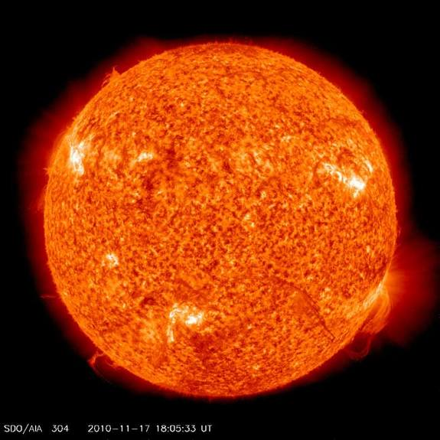
The ultimate source of energy for atmospheric
and oceanic circulations.
The Sun
Notes:
http://www.srh.noaa.gov/jetstream/global/circ.htm

Slide 5
To maintain a steady temperature,
the energy of incoming shortwave solar radiation must equal
the energy of outgoing longwave radiation emitted by Earth/atmos.
energetic
less energetic
no atmosphere
–18°C
Earth’s surface
Notes:
If the Earth had no atmosphere, the radiative equilibrium temperature (global annual average) would be –18°C. Each photon of solar radiation is worth twice that of longwave radiation for illustration purposes here.

Slide 6
energetic
less energetic
top of atmosphere
greenhouse gases
15°C
Earth’s surface
Notes:
With an atmosphere with the present level of greenhouse gases, it would be more difficult for infrared radiation to escape to space. To have enough radiation make it out to space, the temperature heats up, bringing the atmosphere to a globally and annually averaged radiative-equilibrium temperature of 15°C.

Slide 7
energetic
less energetic
top of atmosphere
more greenhouse gases
20°C
Earth’s surface
Notes:
With even more greenhouse gases in the atmosphere, even higher temperatures would occur because of the increased difficulty of getting infrared radiation out to space.

Slide 8
dimmer Sun
energetic
less energetic
top of atmosphere
even more greenhouse gases
20°C
Earth’s surface
Notes:
Cutting the solar output but adding even more greenhouse gases and we could keep the same temperature.

Slide 9
energetic
less energetic
top of atmosphere
even more greenhouse gases
15°C
ice
Albedo is the fraction of solar radiation reflected by a surface.
Earth’s surface
Notes:
If we add reflective surfaces (such as ice), then we have to account for less emission to space, so temperature drops.

Slide 10
The Earth’s climate can be regulated by the amount of incoming
solar radiation (solar constant), the albedo of the Earth, and
the concentration of greenhouse gases.
energetic
less energetic
top of atmosphere
even more greenhouse gases
15°C
ice
Earth’s surface

Slide 11
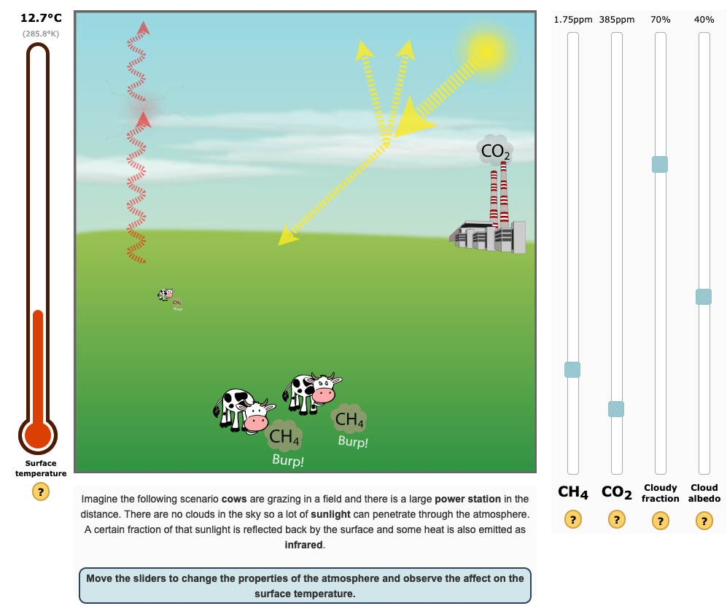
GHGs
albedo
https://personalpages.manchester.ac.uk/staff/paul.connolly/teaching/climatesim/index.html

Slide 12
General circulation of the Earth’s atmosphere

Slide 13
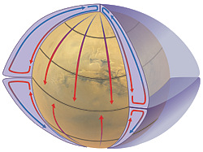
Atmospheric circulation on a non-rotating Earth
(tilt not shown)
NOAA
Notes:
http://www.srh.noaa.gov/jetstream/global/circ.htm

Slide 14
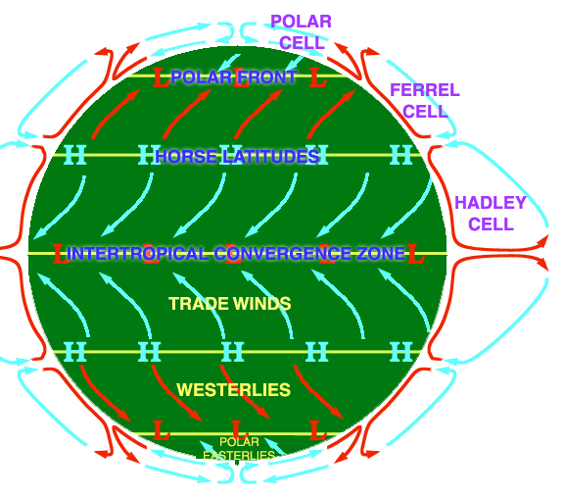
Converging air goes up.
Air that goes up produces
clouds and precipitation.
By DWindrim (Own work) [GFDL (www.gnu.org/copyleft/fdl.html) or CC-BY-SA-3.0 (http://creativecommons.org/licenses/by-sa/3.0/)], via Wikimedia Commons
Notes:
http://www.iupui.edu/~g115/assets/mod08/circulation_cells.JPG

Slide 15
Converging air goes up.
Air that goes up produces
clouds and precipitation.
The polar fronts at the
surface are associated
with a jet stream aloft.
The jet streams blow
from west to east.
COLD AIR
WARM AIR
HOT AIR
By DWindrim (Own work) [GFDL (www.gnu.org/copyleft/fdl.html) or CC-BY-SA-3.0 (http://creativecommons.org/licenses/by-sa/3.0/)], via Wikimedia Commons
Notes:
http://www.iupui.edu/~g115/assets/mod08/circulation_cells.JPG

Slide 16
Converging air goes up.
Air that goes up produces
clouds and precipitation.
The polar fronts at the
surface are associated
with a jet stream aloft.
The jet streams blow
from west to east.
Polar Jet Stream
Polar Jet Stream
By DWindrim (Own work) [GFDL (www.gnu.org/copyleft/fdl.html) or CC-BY-SA-3.0 (http://creativecommons.org/licenses/by-sa/3.0/)], via Wikimedia Commons
Notes:
http://www.iupui.edu/~g115/assets/mod08/circulation_cells.JPG

Slide 17
Three cells in each
hemisphere on Earth
The number of circulation
cells per hemisphere is
a function of rotation rate
of the planet and its size.
Polar Jet Stream
Polar Jet Stream
By DWindrim (Own work) [GFDL (www.gnu.org/copyleft/fdl.html) or CC-BY-SA-3.0 (http://creativecommons.org/licenses/by-sa/3.0/)], via Wikimedia Commons
Notes:
http://www.iupui.edu/~g115/assets/mod08/circulation_cells.JPG

Slide 18
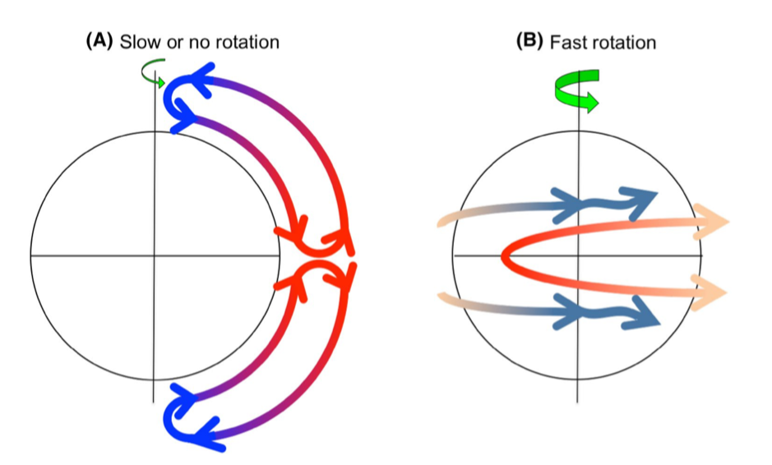
O’Brien (2019, https://doi.org/10.1007/s41748-019-00128-7)

Slide 19
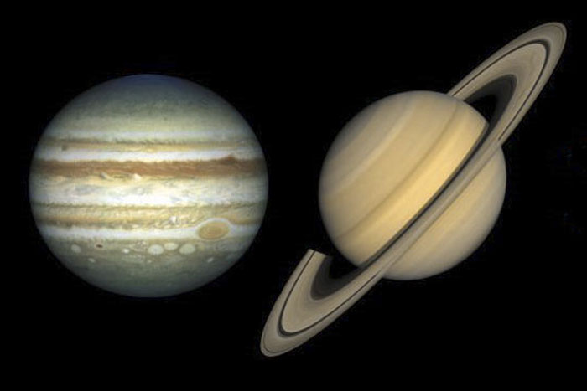
Jupiter: 11 times bigger, 10 h
Saturn: 9 times bigger, 10 h

Slide 20
Notes:
http://www.iupui.edu/~g115/assets/mod08/circulation_cells.JPG

Slide 21
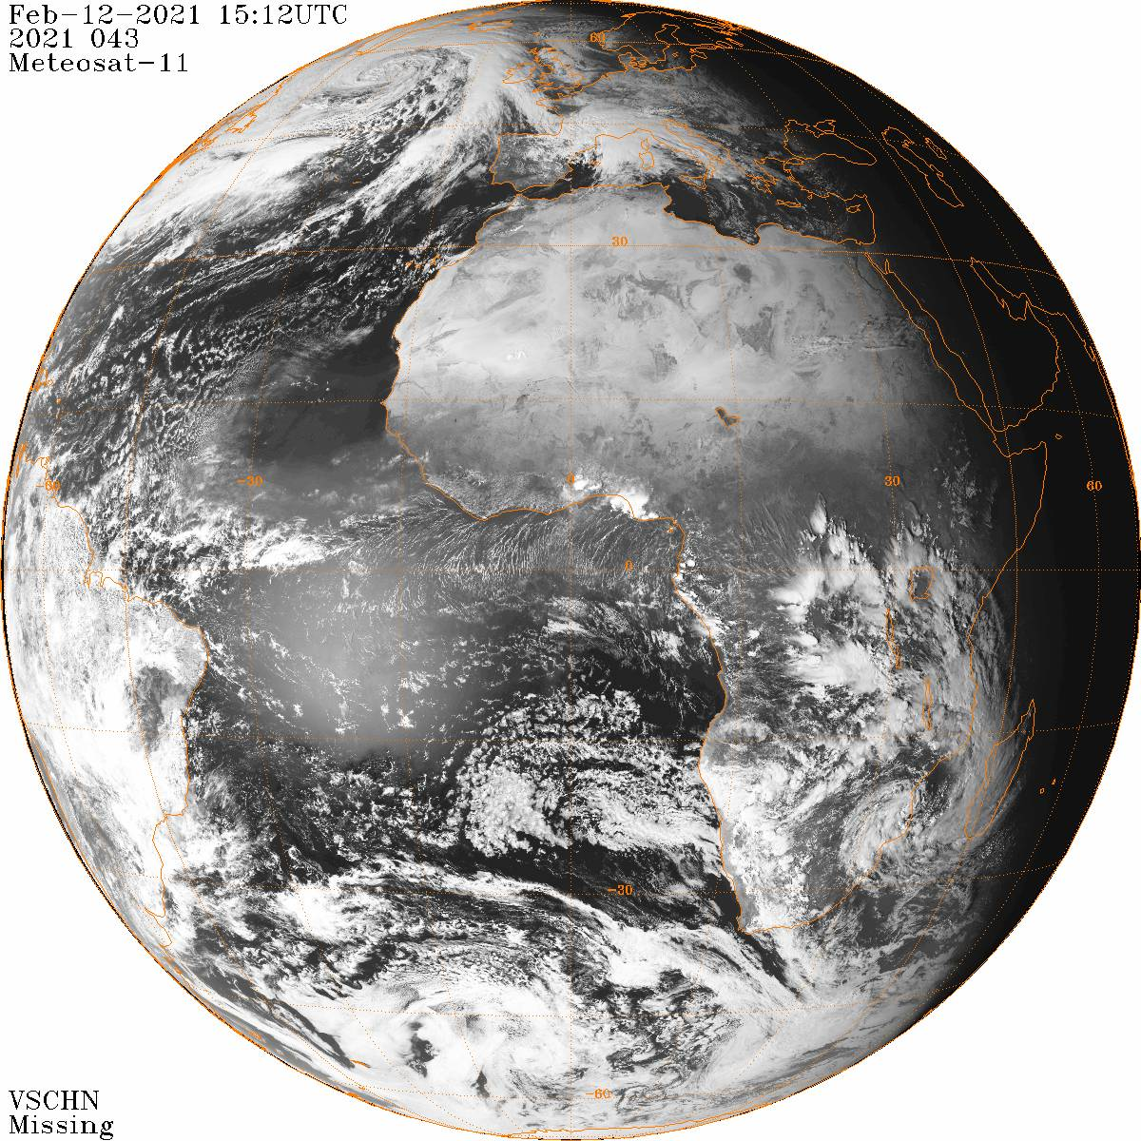
Meteosat-11 is a geostationary satellite.
midlatitude cyclone
subtropical
high pressure
windblown sand
from Sahara
Intertropical
Convergence
Zone (ITCZ)
day–night
terminator
convective storms
over Amazon
shallow clouds
in subtropical
high pressure
sun reflecting
off ocean (glint)
midlatitude
cyclone
NOAA
https://www.ncdc.noaa.gov/gibbs
Notes:
To access the latest full-disc satellite imagery from all geostationary satellites, see https://www.ncdc.noaa.gov/gibbs.
https://rammb-slider.cira.colostate.edu/?sat=meteosat-0deg&sec=full_disk&x=1856&y=1858&z=0&angle=0&im=12&ts=1&st=0&et=0&speed=130&motion=loop&maps%5Bborders%5D=white&p%5B0%5D=geocolor&opacity%5B0%5D=1&pause=0&slider=-1&hide_controls=0&mouse_draw=0&follow_feature=0&follow_hide=0&s=rammb-slider&draw_color=FFD700&draw_width=6

Slide 22
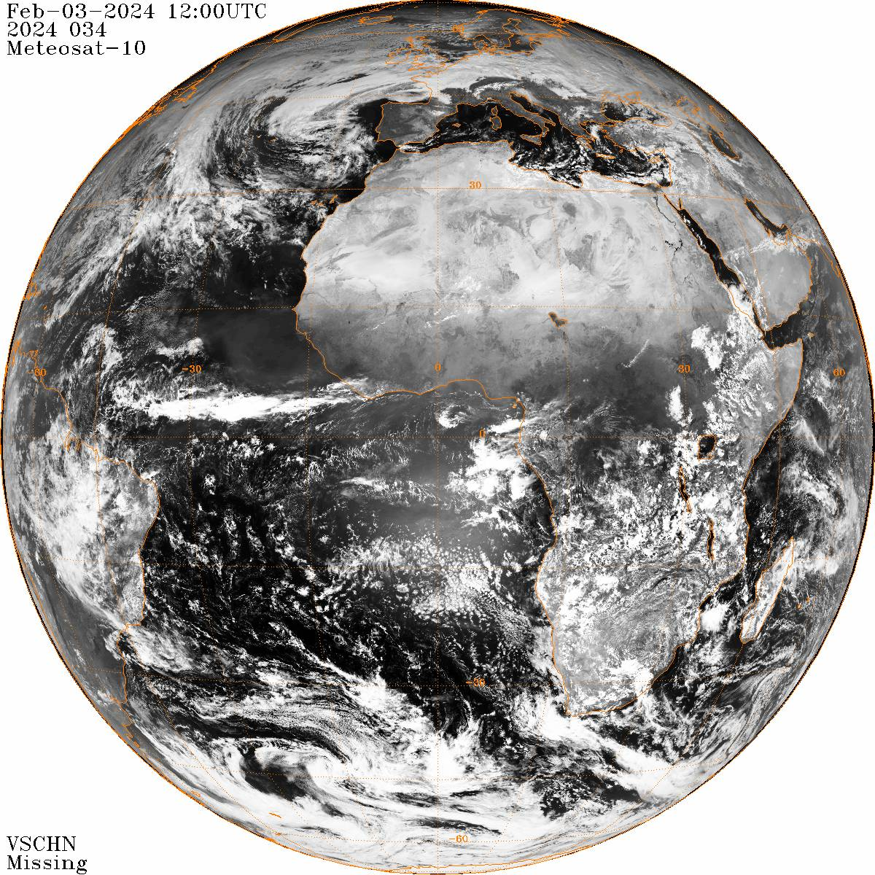
snow in Alps
subtropical
high pressure
Intertropical
Convergence
Zone (ITCZ)
shallow clouds
in subtropical
high pressure
sun reflecting
off ocean (glint)
NOAA
https://www.ncdc.noaa.gov/gibbs
Notes:
To access the latest full-disc satellite imagery from all geostationary satellites, see https://www.ncdc.noaa.gov/gibbs.
https://en.allmetsat.com/images/msg_vis.php

Slide 23
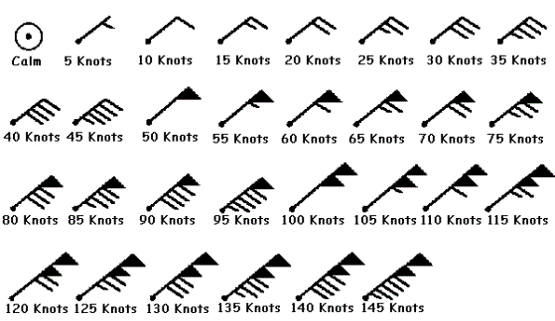
Wind barbs indicate the direction the
wind is coming from and its speed.
These are all winds from the northeast.
Notes:
https://blog.mapbox.com/mapping-wind-barbs-to-show-speed-and-direction-4d3078add03d

Slide 24
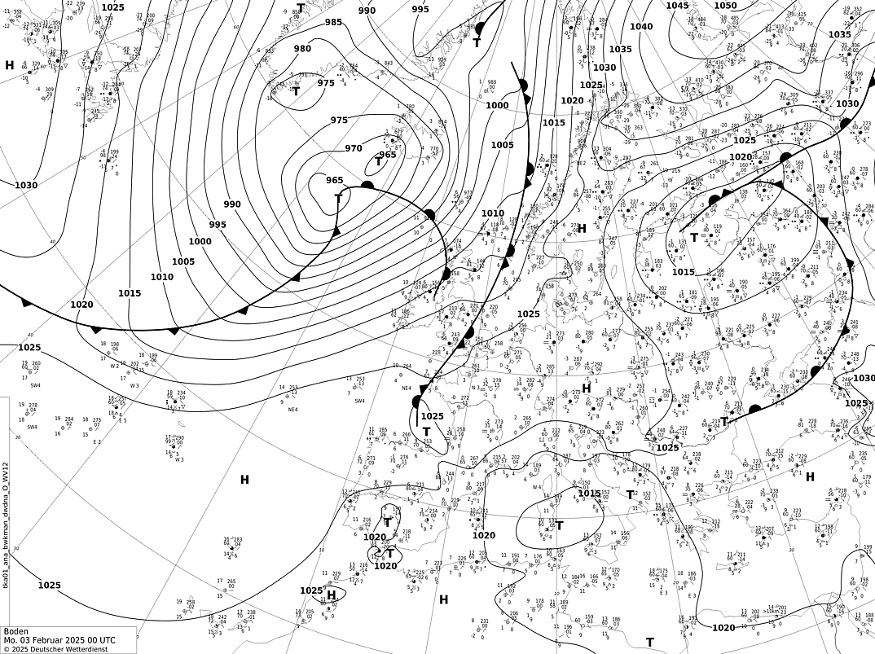
H
H
T = low
H = high
L
L
surface
weather
map for
0000 UTC
3 Feb 2025
isobars:
lines of
constant
sea-level
pressure
(DWD)
Manchester
H
Notes:
Maps from http://wetter3.de

Slide 25
H
H
T = low
H = high
L
–4°C
warm front
L
10°C
surface
weather
map for
0000 UTC
3 Feb 2025
isobars:
lines of
constant
sea-level
pressure
(DWD)
cold front
5°C
Manchester
Manchester
H
Notes:
Maps from http://wetter3.de

Slide 26
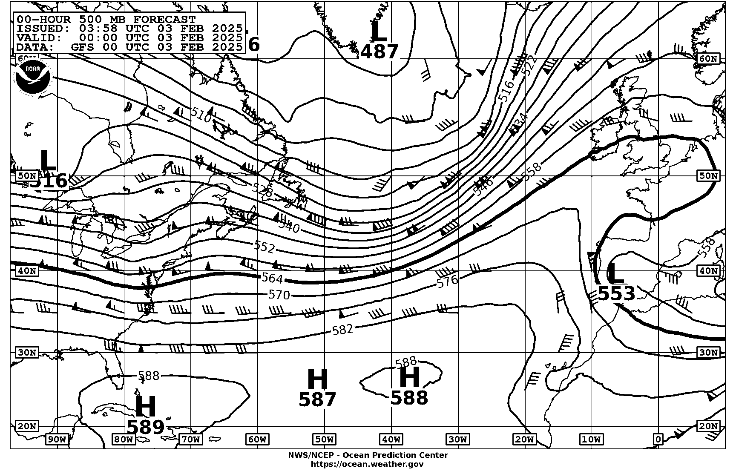
Height of 500-hPa surface
(dam, 540 = 5.4 km)

Slide 27
jet stream
(closely packed
height lines)
Height of 500-hPa surface
(dam, 540 = 5.4 km)

Slide 28
Differential heating between tropics and poles drives the atmospheric circulation, modified by rotation of Earth
Intertropical Convergence Zone, subtropical anticyclones,
polar front and polar jet stream

Slide 29
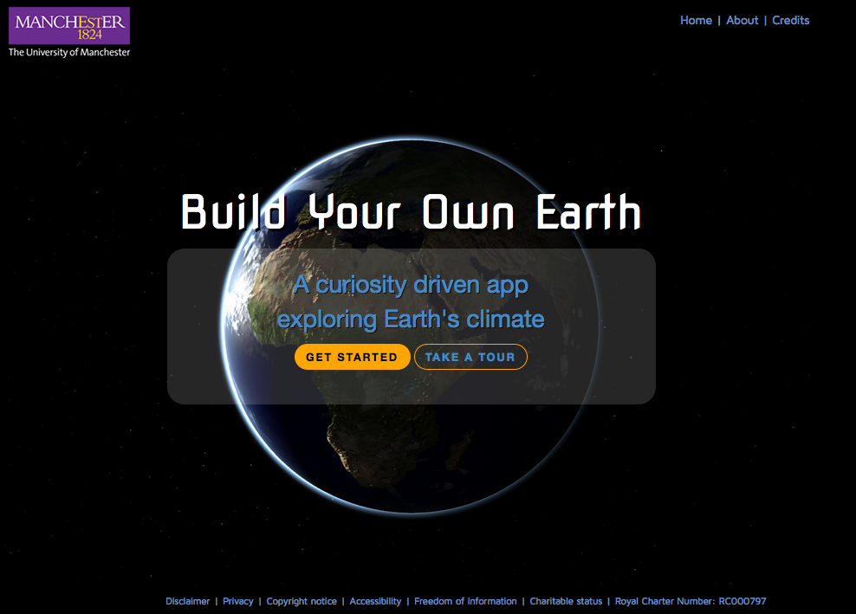
BuildYourOwnEarth.com

Slide 30
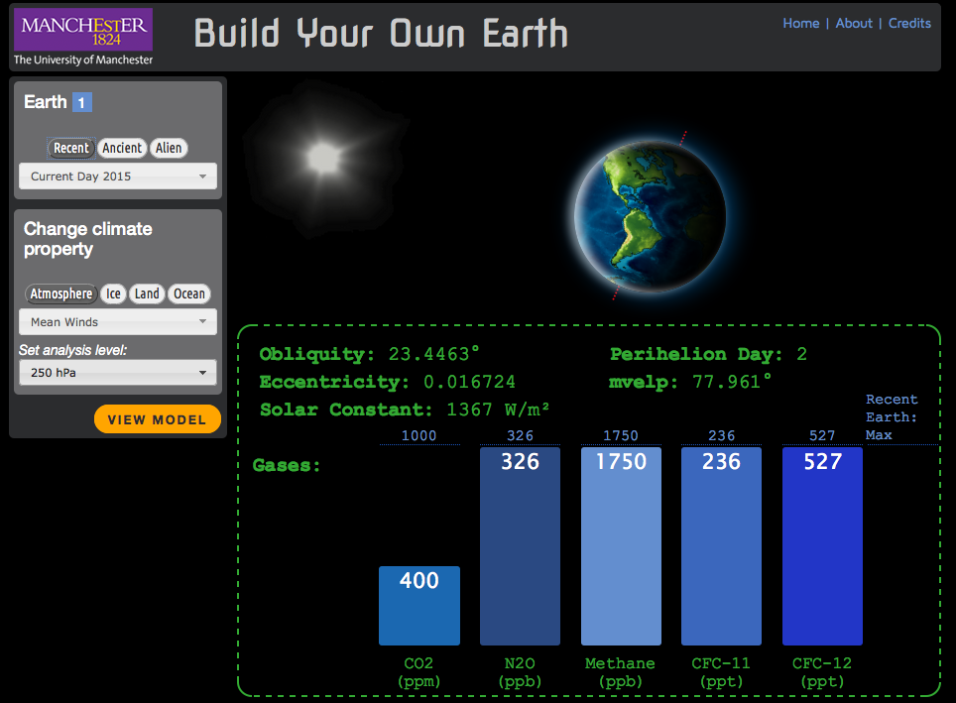

Slide 31
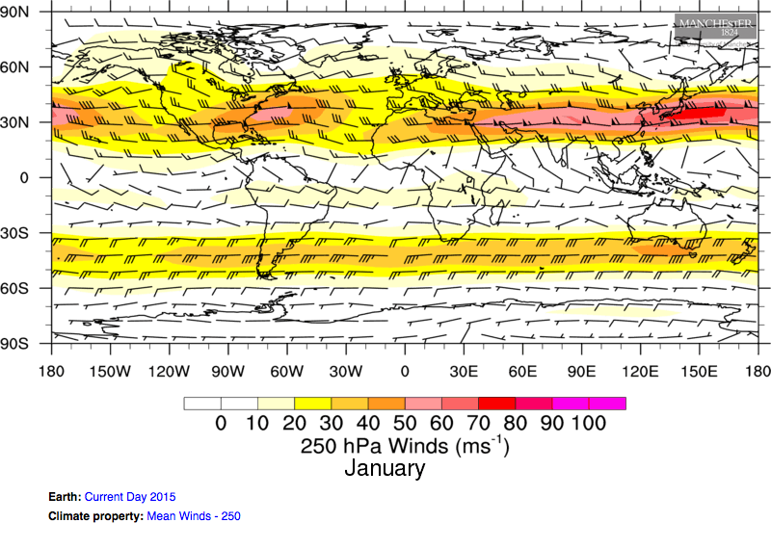
about 10 km height
near tropopause where
polar jet stream winds are maximum
hPa (hectopascal) = mb (millibar)
Build Your Own Earth

Slide 32
about 10 km height
near tropopause where
polar jet stream winds are maximum
Build Your Own Earth

Slide 33
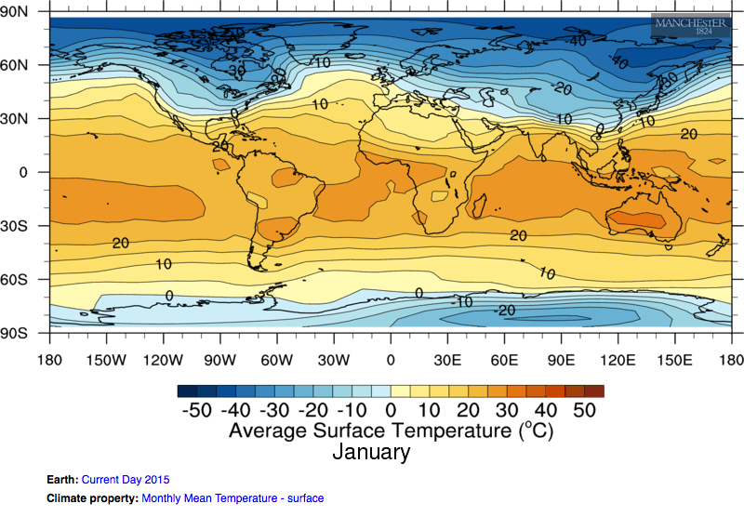
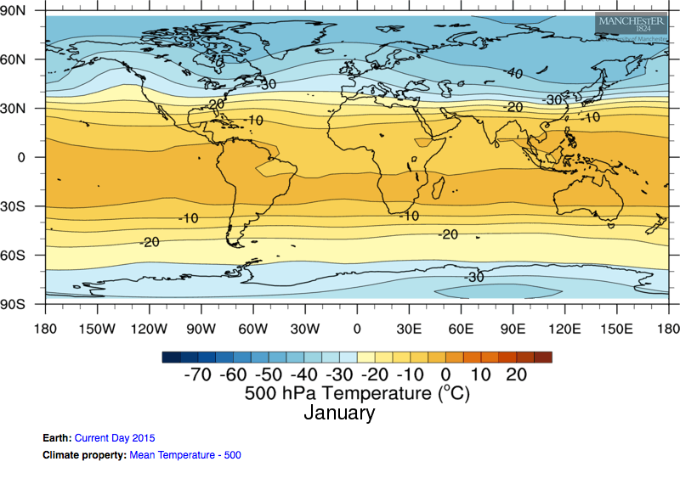
about 5.5 km height
in middle troposphere
Build Your Own Earth

Slide 34
Build Your Own Earth

Slide 35
Build Your Own Earth

Slide 36
Build Your Own Earth

Slide 37
Build Your Own Earth

Slide 38
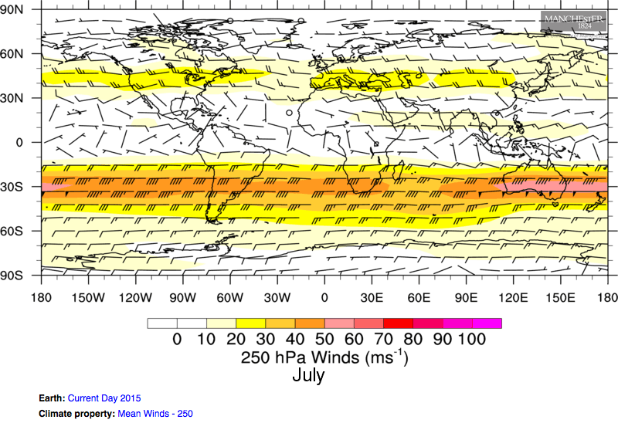
Southern Hemisphere jet is more straight
Polar jet stream is stronger in winter hemisphere
Build Your Own Earth

Slide 39
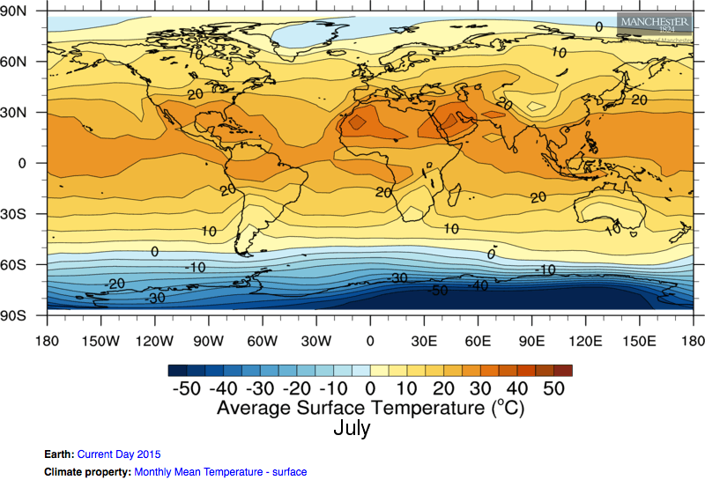
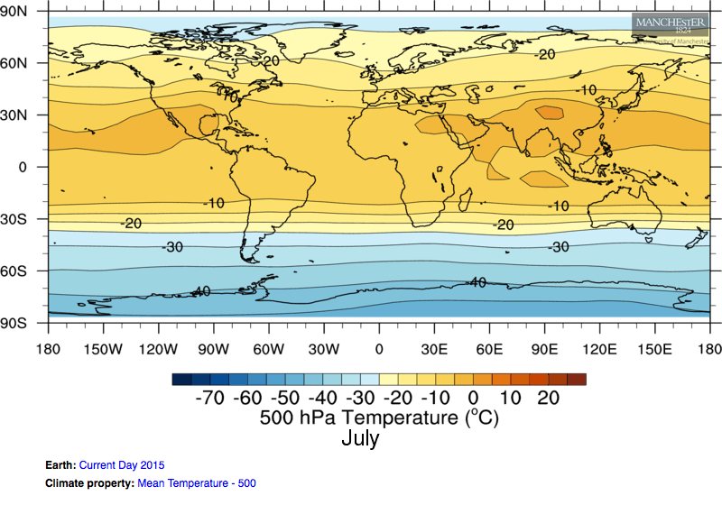
Build Your Own Earth

Slide 40
The jet stream separates polar air from tropical air.
The jet stream is stronger in the winter hemisphere.
The jet stream ridges over wide mountain ranges and troughs downstream of them.

Slide 41
How we measure humidity in the air

Slide 42
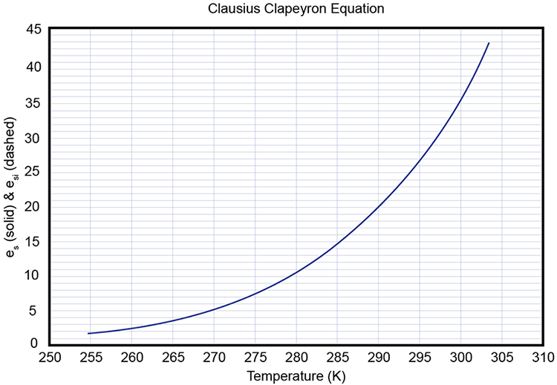
The saturation vapor pressure (e_{s}) tells us how much water vapor would be in the
atmosphere at equilibrium in a closed container.
Recall mean
sea-level
pressure is
1013.25 hPa.
So, 30 hPa of
water vapor
would be about
3% of the mass
of the atmosphere.
saturation vapor pressure (e_{s}, hPa)

Slide 43
The saturation vapor pressure (e_{s}) tells us how much water vapor would be in the
atmosphere at equilibrium in a closed container.
Recall mean
sea-level
pressure is
1013.25 hPa.
So, 30 hPa of
water vapor
would be about
3% of the mass
of the atmosphere.
saturation vapor pressure (e_{s}, hPa)
actual vapor
pressure and
temperature of
an air parcel

Slide 44
The saturation vapor pressure (e_{s}) tells us how much water vapor would be in the
atmosphere at equilibrium in a closed container.
supersaturated air
Recall mean
sea-level
pressure is
1013.25 hPa.
So, 30 hPa of
water vapor
would be about
3% of the mass
of the atmosphere.
saturation vapor pressure (e_{s}, hPa)
saturated air
actual vapor
pressure and
temperature of
an air parcel
unsaturated air

Slide 45
We can measure the amount of water vapor (i.e., humidity)
in the air in an absolute or relative sense.
Absolute amounts of water vapor in the air:
Vapor pressure (e) is the partial pressure of water vapor in the atmosphere (hPa).
Dewpoint temperature (T_{d}) is the temperature to which you would have to cool the
air to reach saturation (i.e., the temperature at which dew would form).
Relative to equilibrium (or saturation) vapor pressure:
Relative humidity = actual vapor pressure/saturation vapor pressure * 100

Slide 46
The saturation vapor pressure (e_{s}) tells us how much water vapor would be in the
atmosphere at equilibrium in a closed container.
saturation vapor pressure (e_{s}, hPa)
2
3
1
Recall mean
sea-level
pressure is
1013.25 hPa.

Slide 47
The saturation vapor pressure (e_{s}) tells us how much water vapor would be in the
atmosphere at equilibrium in a closed container.
saturation vapor pressure (e_{s}, hPa)
Recall mean
sea-level
pressure is
1013.25 hPa.

Slide 48
The saturation vapor pressure (e_{s}) tells us how much water vapor would be in the
atmosphere at equilibrium in a closed container.
saturation vapor pressure (e_{s}, hPa)
add water
vapor
to air (no
change to T)
Recall mean
sea-level
pressure is
1013.25 hPa.
cool air (no
change to water
vapor content)

Slide 49
T = 290 K
T = 290 K
T = 279 K
T_{d} = 279 K
T_{d} = 290 K
T_{d} = 279 K
e_{s} = 20 hPa
20 hPa
10 hPa
e = 10 hPa
RH = 10/20 * 100
RH = 50%
RH = 20/20 * 100
RH = 100%
RH = 10/10 * 100
RH = 100%
Notes:
Two ways to reach saturation from the red point.

Slide 50

T = 290 K
T = 290 K
T = 279 K
T_{d} = 279 K
T_{d} = 290 K
T_{d} = 279 K
e_{s} = 20 hPa
20 hPa
10 hPa
e = 10 hPa
RH = 10/20 * 100
RH = 50%
RH = 20/20 * 100
RH = 100%
RH = 10/10 * 100
RH = 100%
add water vapor to air
(no change to T)

Slide 51
T = 290 K
T = 279 K
T_{d} = 279 K
T_{d} = 279 K
e_{s} = 20 hPa
e = 10 hPa
e = 10 hPa
cool air
(no change to water
vapor content)
RH = 10/20 * 100
RH = 50%
RH = 10/10 * 100
RH = 100%

Slide 52
The saturation vapor pressure (e_{s}) tells us how much water vapor would be in the
atmosphere at equilibrium in a closed container.
What happens
if 2 ➡ 3?
saturation vapor pressure (e_{s}, hPa)
2
add moisture to air
3
1
cool the air

Slide 53
The saturation vapor pressure (e_{s}) tells us how much water vapor would be in the
atmosphere at equilibrium in a closed container.
What happens
if 2 ➡ 3?
cool the air ➡
condensation
saturation vapor pressure (e_{s}, hPa)
2
add moisture to air
3
1
cool the air

Slide 54
The saturation vapor pressure (e_{s}) tells us how much water vapor would be in the
atmosphere at equilibrium in a closed container.
What happens
if 2 ➡ 3?
cool the air ➡
condensation
saturation vapor pressure (e_{s}, hPa)
2
add moisture to air
3
1
cool the air

Slide 55
A practical example of
dry and moist adiabatic motion

Slide 56
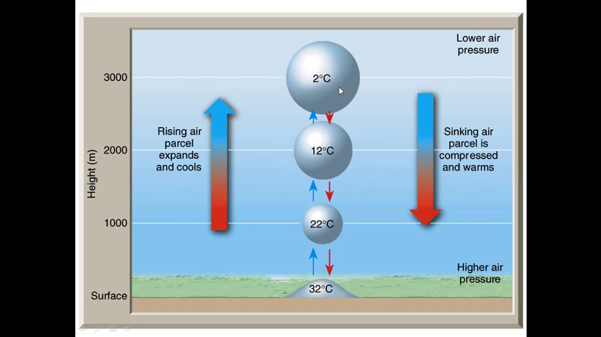
As long as the air parcel remains unsaturated…

Slide 57
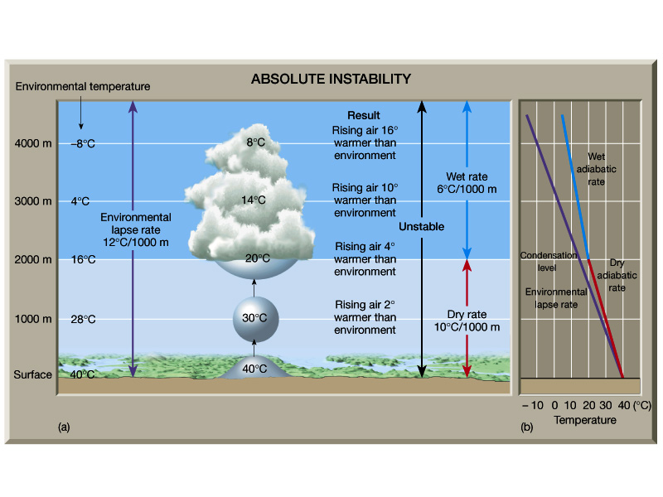
Once the air parcel becomes saturated, latent heat is
released to the atmosphere, offsetting dry adiabatic
cooling due to expansion.
Moist
moist adiabatic lapse rate: varies, but 5–8°C/km

Slide 58
Dry and moist adiabatic motion

Slide 59
3 km
2 km
1 km
0 km
T = 25°C
T_{d} = 5°C

Slide 60
3 km
2 km
T = ?
T_{d} = ?
1 km
0 km
T = 25°C
T_{d} = 5°C

Slide 61
3 km
2 km
T = 15°C
T_{d} = 5°C
1 km
0 km
T = 25°C
T_{d} = 5°C

Slide 62
3 km
T = ?
T_{d} = ?
2 km
T = 15°C
T_{d} = 5°C
1 km
0 km
T = 25°C
T_{d} = 5°C

Slide 63
3 km
T = 5°C
T_{d} = 5°C
2 km
T = 15°C
T_{d} = 5°C
1 km
0 km
T = 25°C
T_{d} = 5°C

Slide 64
3 km
T = 5°C
T_{d} = 5°C
2 km
T = 15°C
T_{d} = 5°C
1 km
0 km
T = 25°C
T_{d} = 5°C

Slide 65
T = ?
T_{d} = ?
3 km
T = 5°C
T_{d} = 5°C
2 km
T = 15°C
T_{d} = 5°C
1 km
0 km
T = 25°C
T_{d} = 5°C

Slide 66
T = 0°C
T_{d} = 0°C
3 km
T = 5°C
T_{d} = 5°C
2 km
T = 15°C
T_{d} = 5°C
1 km
0 km
T = 25°C
T_{d} = 5°C

Slide 67
T = 0°C
T_{d} = 0°C
3 km
T = 5°C
T_{d} = 5°C
2 km
What is the shape of a raindrop?
T = 15°C
T_{d} = 5°C
1 km
0 km
T = 25°C
T_{d} = 5°C
A
B
C
D
E

Slide 68
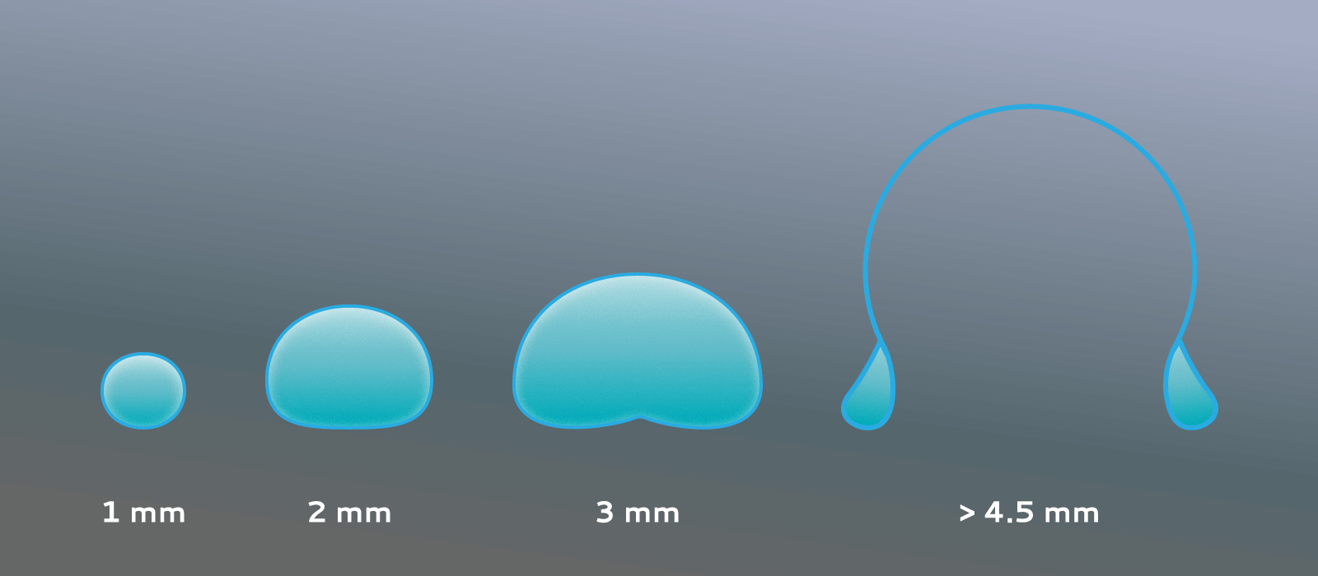
T = 0°C
T_{d} = 0°C
3 km
T = 5°C
T_{d} = 5°C
2 km
What is the shape of a raindrop?
T = 15°C
T_{d} = 5°C
1 km
0 km
T = 25°C
T_{d} = 5°C
A
B
C
D
E

Slide 69
T = 0°C
T_{d} = 0°C
3 km
T = ?
T_{d} = ?
T = 5°C
T_{d} = 5°C
2 km
T = 15°C
T_{d} = 5°C
1 km
0 km
T = 25°C
T_{d} = 5°C

Slide 70
T = 0°C
T_{d} = 0°C
3 km
T = 10°C
T_{d} = 0°C
T = 5°C
T_{d} = 5°C
2 km
T = 15°C
T_{d} = 5°C
1 km
0 km
T = 25°C
T_{d} = 5°C

Slide 71
T = 0°C
T_{d} = 0°C
3 km
T = 10°C
T_{d} = 0°C
T = 5°C
T_{d} = 5°C
2 km
T = ?
T_{d} = ?
T = 15°C
T_{d} = 5°C
1 km
0 km
T = 25°C
T_{d} = 5°C

Slide 72
T = 0°C
T_{d} = 0°C
3 km
T = 10°C
T_{d} = 0°C
T = 5°C
T_{d} = 5°C
2 km
T = 20°C
T_{d} = 0°C
T = 15°C
T_{d} = 5°C
1 km
0 km
T = 25°C
T_{d} = 5°C

Slide 73
T = 0°C
T_{d} = 0°C
3 km
T = 10°C
T_{d} = 0°C
T = 5°C
T_{d} = 5°C
2 km
T = 20°C
T_{d} = 0°C
T = 15°C
T_{d} = 5°C
1 km
0 km
T = ?
T_{d} = ?
T = 25°C
T_{d} = 5°C

Slide 74
T = 0°C
T_{d} = 0°C
3 km
T = 10°C
T_{d} = 0°C
T = 5°C
T_{d} = 5°C
2 km
T = 20°C
T_{d} = 0°C
T = 15°C
T_{d} = 5°C
1 km
0 km
T = 30°C
T_{d} = 0°C
T = 25°C
T_{d} = 5°C

Slide 75
T = 0°C
T_{d} = 0°C
3 km
T = 10°C
T_{d} = 0°C
T = 5°C
T_{d} = 5°C
2 km
T = 20°C
T_{d} = 0°C
T = 15°C
T_{d} = 5°C
1 km
0 km
T = 30°C
T_{d} = 0°C
T = 25°C
T_{d} = 5°C
Lee-side air is 5°C warmer and drier.

Slide 76
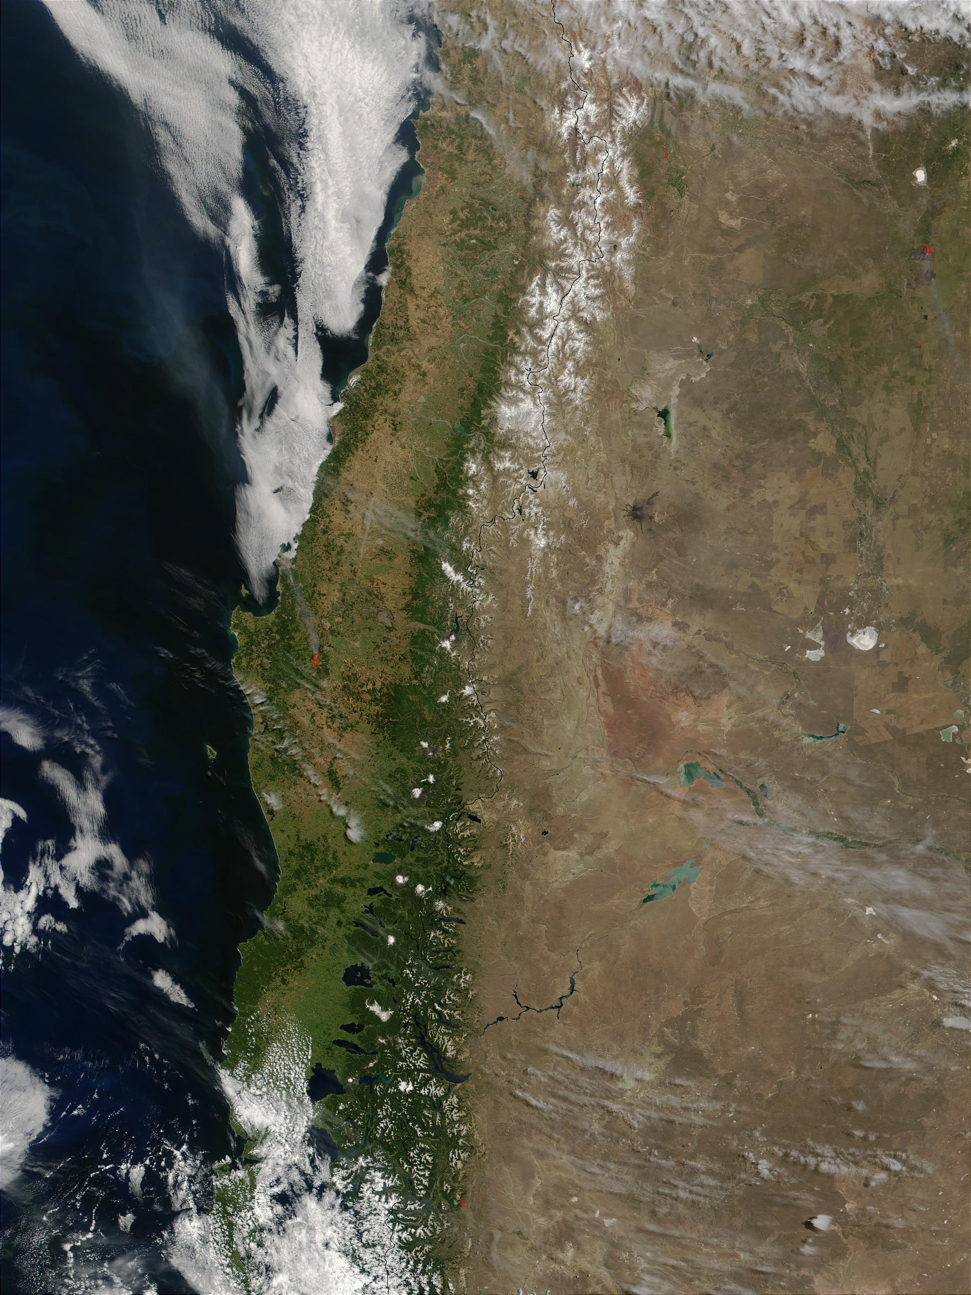
jet stream
Andes rain shadow
Notes:
https://visibleearth.nasa.gov/images/57447/chile-and-argentina

Slide 77
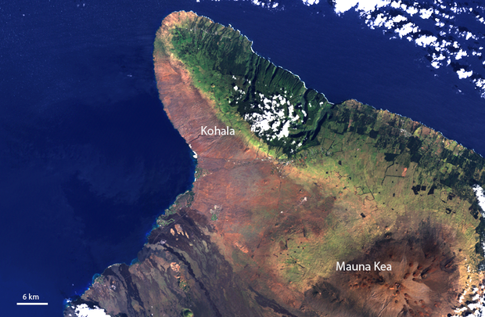
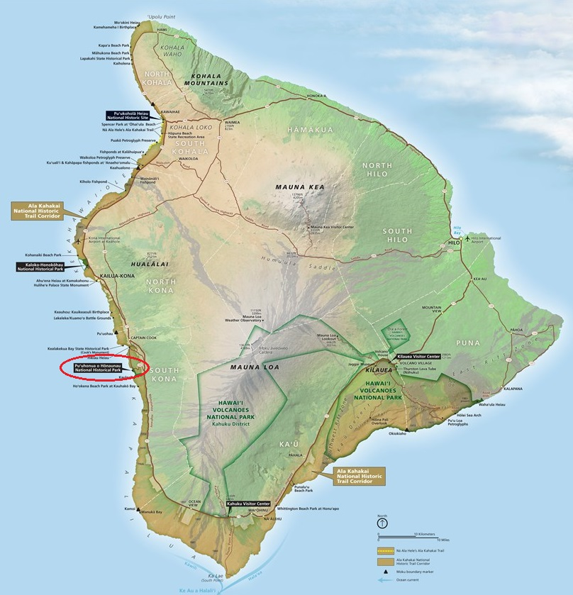
northeast
trade winds
Hawaii
rain shadow
Notes:
https://www.climate.gov/news-features/featured-images/rain-shadows-summits-hawaii

Slide 78
Summary
The atmospheric circulation is determined by the size of Earth and its rotation rate.
Greenhouse gases make the Earth’s surface warmer than it would be without them.
Midlatitude weather is dominated by the jet stream and its associated high and low pressure patterns.
Rising unsaturated air cools at 10°C per km; sinking air warms at the same rate.
Condensation releases latent heat, which warms the air.

Slide 79
For Week 4...
Videos:
Extratropical cyclones
How does the jet stream control the weather in the midlatitudes?
Weather around the world
Both Sides Now: Clouds
Required Reading:
Midlatitude Cyclones (Schultz 2011)
552262

Slide 80
On your computer’s or phone’s web browser, go to
kahoot.it
You can download the kahoot app or bookmark the website for future lectures.

